Slide 1
BREAKO^{U}T
CS360 PROJECT
NORA ALSHAALAN
NORAH ALSABTI

Slide 2
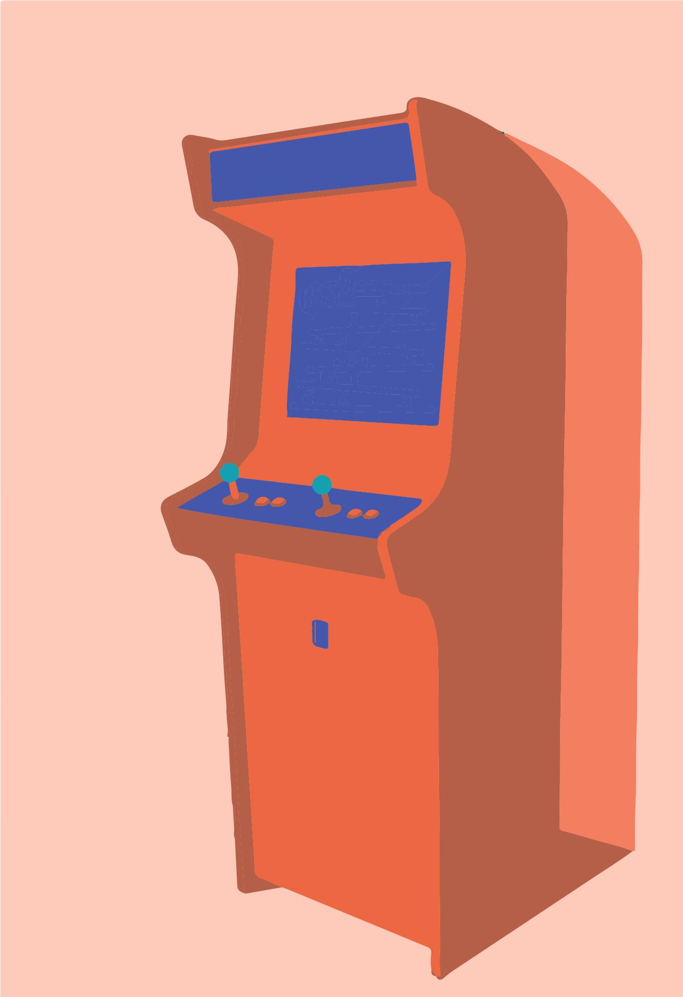
WHAT IS BREAKOUT?
Breakout is an arcade game developed and published by Atari, Inc.
The game was ported to multiple platforms and upgraded to video games such as Super Breakout.
Atari, Inc. was an American video game development and home computer company founded in 1972 by Nolan Bushnell and Ted Dabney [1].

Slide 3
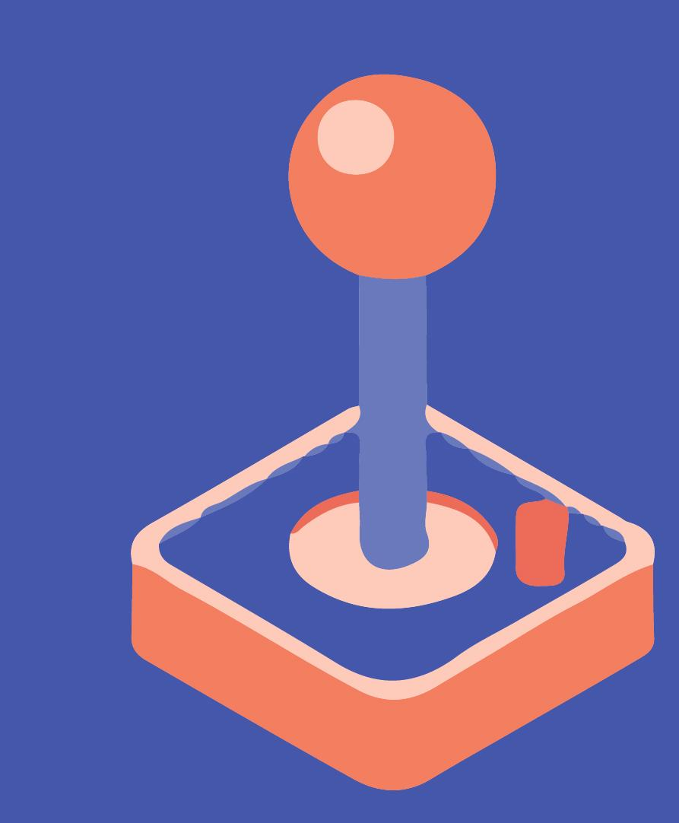
GAME PLAY
The game consists of layers of blocks, a ball, and a movable controller block.
The game start once the player presses SPACE bar.
It starts with the ball traveling across the screen, bouncing off the top and side walls of the screen as well as on the movable controller, which moves by pressing the right and left keys.
When a block is hit, the ball bounces away and the block is destroyed.
If the ball falls, the player loses.

Slide 4
LET’S PLAY

Slide 5

IMPLEMENTATION
PROGRAM INFRASTRUCTURE
BLOCKS CLASS
CONTROLLER CLASS
BALL CLASS
Point Coordinates
Detect Collision
Play Piano Notes
Point Coordinates
Detect Collision
Move
Point Coordinates
Velocity
4 Arrays of size 2
( x , y )
4 Arrays of size 2
( x , y )
Center Point & Radius
(Vx, Vy)

Slide 6
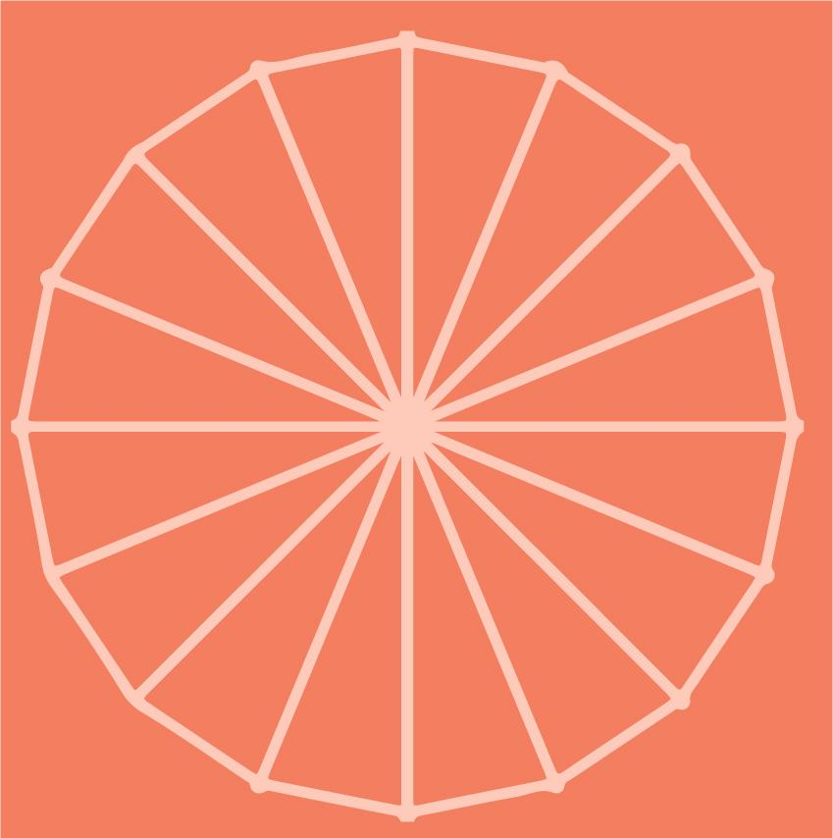
CONSTRUCT & DRAW
Blocks[][] BLOCKS[i][j] = new Blocks[rows][cols]....;
GL_QUADS
Controller player = new Controller....;
GL_QUADS
Ball ball = new Ball....;
GL_TRIANGLE_FAN

Slide 7
CONTROLLER
It’s not just bouncing back
The controller applies friction force to the BALL that will alter the bouncing behavior.
Low
Friction Force
High
Friction Force
High
Friction Force
ratio= (collisionPoint - ControllerCenter) / WIDTH
Vx= ratio * V
Vy= (1-ratio)* V

Slide 8
BALL MOVEMENT
(0,0)
Top Boundary
Ball.CenterX += Vx;
Ball.CenterY += Vy;
To make sure it doesn’t fly out of the borders
center
Vy
-Vy
public void withinBorders(){
if(CenterX+ R >= WIDTH || CenterX-R <= 0.0)
Vel_com[0]*= -1;
else if(CenterY - R <= 0 )
Vel_com[1]*= -1;
}
Left Boundary
-Vx
Right Boundary
Vx
(WIDTH,HEIGHT)

Slide 9
COLLISION DETECTION
No overlap
AABB collisions [3]
Axis-aligned bounding box
PROBLEM
This is considered collision
One axis overlap
Two axis overlap

Slide 10
CHALLENGE
AABB - Circle collision detection
Finding P
Half-width w
radius
C
P
D= C - B
Half-height h
clamped.y
clamped.x
B

Slide 11
BOUNCING BACK
PROBLEM
This is very hard to implement
+X
Y
+Y
X
Vy= -Vy
Vx= -Vx
Vx= V * x/r
Vy= V * y/r

Slide 12
SOLUTION
ROUGH APPROXIMATION
Flip Vy
Flip Vx
Flip Vx
Flip Vy

Slide 13
BREAKING BLOCKS
//In display(GLAutoDrawable drawable)
if( !BLOCKS[i][j].isBroken() ){
//DRAW BLOCKS
}
if( !BLOCKS[i][j].isBroken() && BLOCKS[i][j].collision(ball) )
BLOCKS[i][j].break_it();

Slide 14
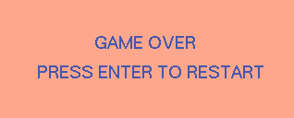
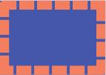
ALSO USED
VK_RIGHT
CONTROLLER
VK_LEFT
GLEventListener
VK_SPACE
START
VK_ENTER
NEW GAME
glutBitmapCharacter [2]
GL_TEXTURE_2D

Slide 15
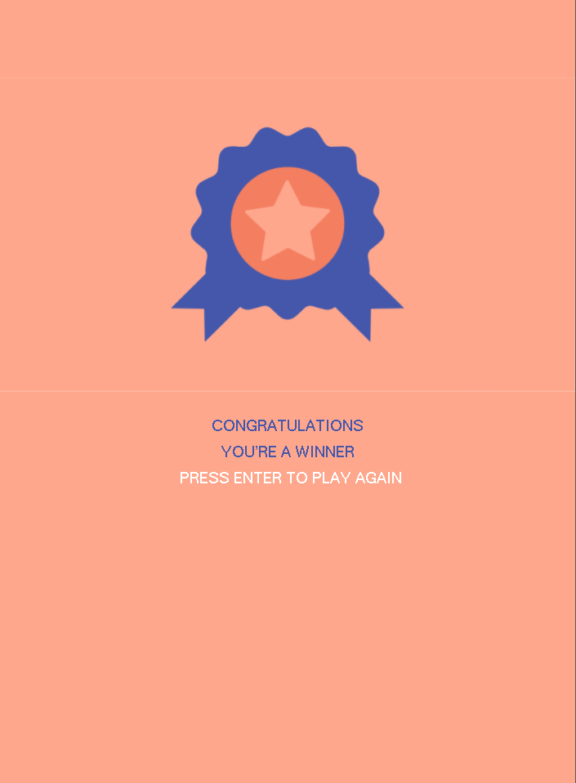
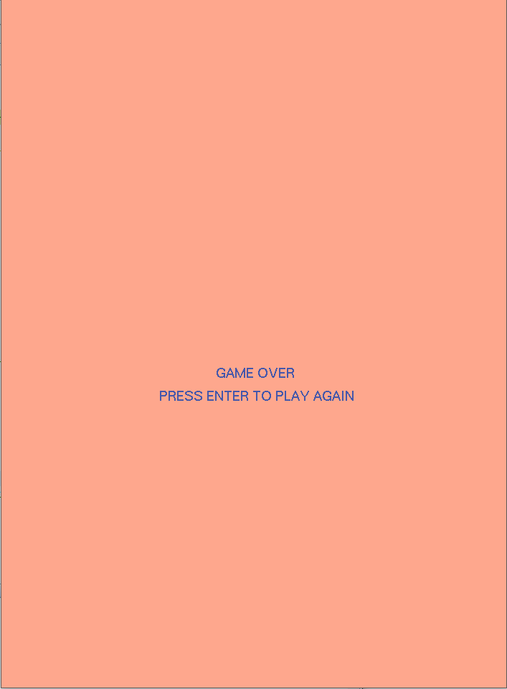
SCENARIOS
All blocks destroyed
WINNER
Ball falls down
GAMEOVER

Slide 16


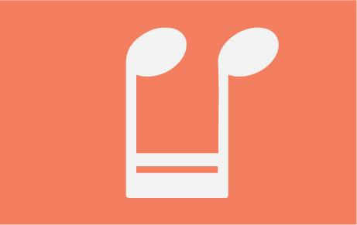



OUR TOUCH

Slide 17
ADDING SOUNDS
EACH BLOCK WAS ASSIGNED A KEY AT THE CREATION STAGE
public boolean collision(Ball b){
//code............
pianoKey(this.key); //pass this block’s key note
}
public static void pianoKey( int i ) {
AudioInputStream audioIn = AudioSystem.getAudioInputStream(new
File ("audio\\"+i+".wav"));
Clip clip = AudioSystem.getClip();
clip.open(audioIn);
clip.start();
}

Slide 18
REFERENCES
[1] Atari History. (2012). Retrieved from https://www.atari.com/history/1972-1984-0
[2] Kilgard, M. (February 23). 10.1 glutBitmapCharacter. Retrieved 1996, from https://www.opengl.org/resources/libraries/glut/spec3/node76.html
[3] DeVries, J. (2015). Collision detection. Retrieved from https://learnopengl.com/In-Practice/2D-Game/Collisions/Collision-detection

